Slide 1

COURT CASE HANDLING SYSTEM(CCHS)
Group No: 1
A.A.T.G.Abeysinghe 2014CS001
Devanarayana.S. 2014CS022
K.C.Edirisinghe 2014CS029
D.T.Fernando 2014CS034
K.Kirishjajini 2014IS043
H.N.A.Nilakshi 2014IS056
Supervisor- Dr. D. N. Ranasinghe
Mentor- Mr. R. N. Rajapakse
Client- Registrar of Colombo District Courts

Slide 2
Introduction
Colombo District Court handles civil cases.
Civil Cases
Money Related
Land Cases
Family Problems

Slide 3

Money Related Cases
Money related cases –
a large number
most important type
complicated procedure
Currently the process takes place manually
CCHS will be developed for the court staff

Slide 4


Flow of activities after Automation
Case Registration
Stamp Duty Process
Fiscal could not handover summons
Summon Serving Process
Serve DS Summons
Fiscal handed over summons
Roll Court Proceedings
Defendant Appears
B
No
Yes
A

Slide 5


B
Record Exparte judgment
Decree process
Inquiry Process
Inquiry Made
NO
Yes
Inquiry Accepted
C
YES
NO
Cease Assets

Slide 6


A
Roll court Normal Proceedings
Bench proceeding
C
Next hearing date
Case result
Final decision given
Finalize Case

Slide 7
Component Diagram
Case Registration
Case Registration
Defendant Submission
Stamp Duty Process
Retrieve Case Details
Summon Serving Process
Summon Serving Process
Roll Court Proceeding
Handle Fiscal Reports
Case Calling Process
Roll Court Normal
CCHS
Decree Process
Bench Proceeding
DS Process
Inquiry Process
Finalize Case
Assets Ceasing Process
Report Generation
Register New User
User Registration
Edit Profile and Reset Password
Database Backup
Notes:
We will explain about each component as we go..

Slide 8
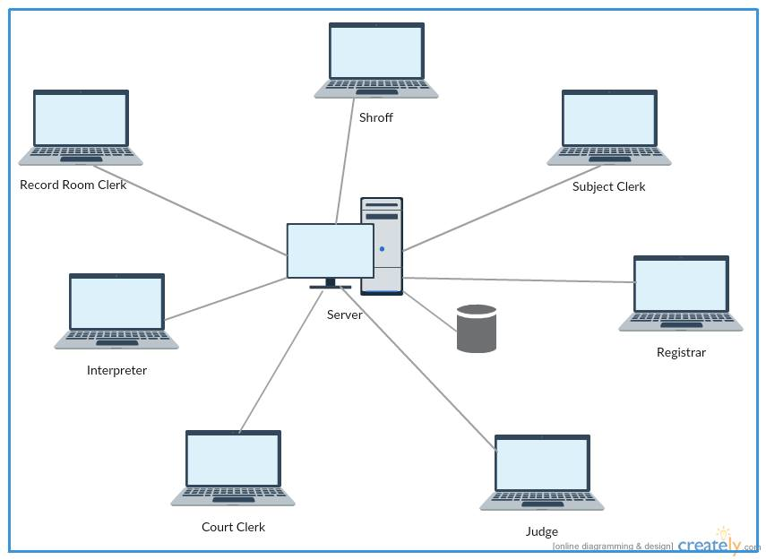
System Architecture
Same system architecture that we proposed earlier.

Slide 9

Progress
Functional Requirements
1. Case Registration
2. Issuing Case Number
3. Calculate Stamp Duty for a case.
4. Issue Stamp Duty Receipt
5. Serve Summons (Print Outs)
6. Handle Fiscal Reports Details
7. Handle Ex party judgments
8. Decree preparation
9. Handle Inquiries
10. Update case details e.g. Next hearing date, Decision
11. Handle Ceasing of assets
12. Registrar finishes the case
13. Prepare Reports
14. Record defendant details per a case
15. Retrieve case details
16. User Registration
17. Take backup of database

Slide 10
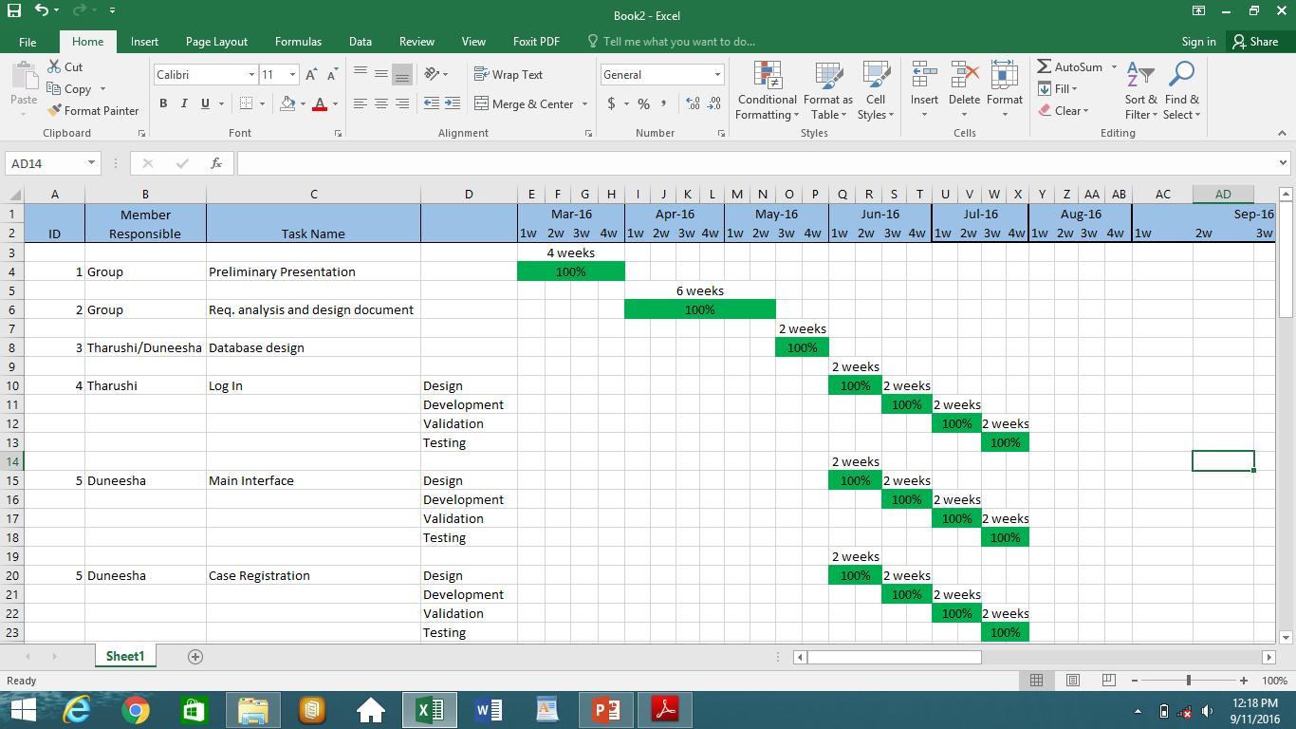

Slide 11
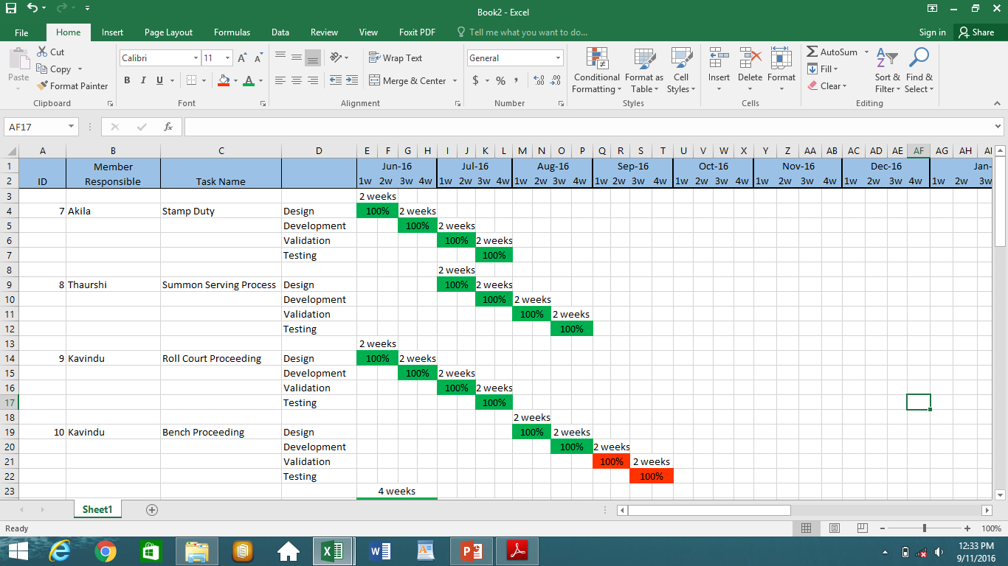

Slide 12
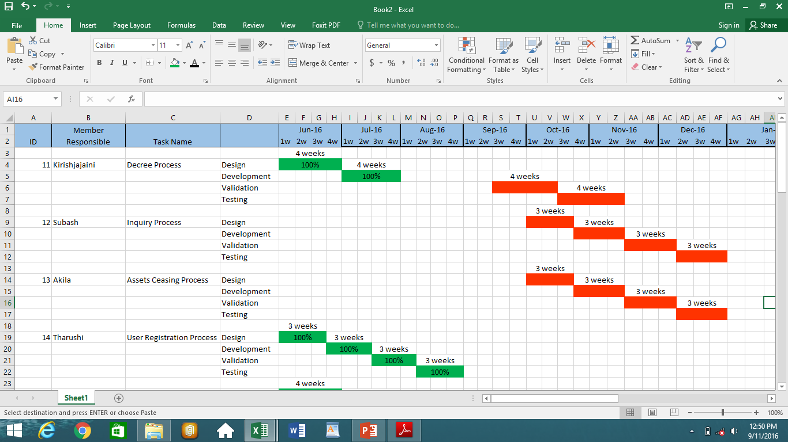

Slide 13
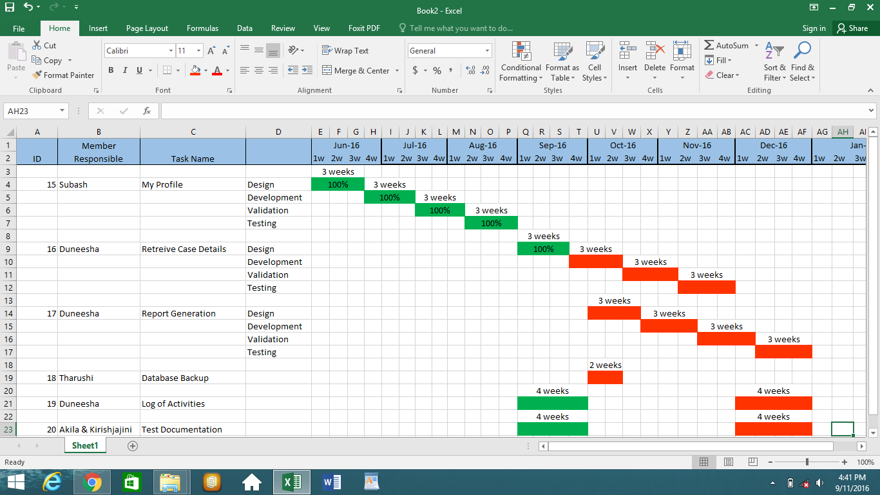

Slide 14

Percentage Completed
More than 50% of the system is estimated to be completed at this point

Slide 15




Technical Exposure
Development :- JavaSE using NetBeans
DBMS :- XAMPP
Report Generation :- Jasper Reports
Version Controlling :- GitHub
https://github.com/DuneeshaFernando/Court-Case-Handling-System

Slide 16
Why did we select JavaSE?
We are developing the software for the use of court staff
Outsiders(plaintiffs ad defendants) should not be given access to the system
Therefore this is developed as a LAN based system.
Access for the staff is not given through internet but through LAN based connection.
Provides high-level classes that are used for
Networking
Security
Database access
Graphical user interface (GUI) development

Slide 17

Quality Assurance Mechanism
Quality Assurance Criteria
E.g.: Correctness, Efficiency, Flexibility, Integrity, Interoperability
Quality Assurance Mechanisms we used
Alpha testing
Black box testing
Glass box testing
Integration testing
Unit testing
Quality Assurance Mechanisms we wish to use
Acceptance testing
Interface testing
System testing

Slide 18

Best Practices
Coding
1 - Commenting & Documentation
2 - Consistent Indentation & Avoid Deep Nesting
3 - Consistent Naming Scheme & Temporary Names
4 - DRY Principle
5 - File and Folder Organization
6 - Capitalize SQL Special Words
7 - Separation of Code and Data
Developers' Best Practices
Documentation, Following standards, Tools & Techniques, Keeping assets safely

Slide 19
Test Plan
Component | Unit Testing |  | Integration Testing | Alpha Testing | System & Acceptance Testing
 | White Box | Black Box
Log In
Main interface
Case Registration
Stamp Duty Process
Summon Serving Process
Roll Court Proceeding
Bench Proceeding
Decree Process
Inquiry Process
Asset Ceasing Process
User Registration
My Profile
Retrieve Case Details
Report Generation
Database Backup
Log of Activities

Slide 20

Deployment Plan
According to initial discussions with the client, deployment of completed components of CCHS will take place after first 6 months.
Since, the existing system is a manual system, new hardware need to be installed.
Main hardware requirements:-
LAN installation with necessary network devices
Server computer & client computers
Backup storage(Removable hard drives for 5 day backups)
We wish to demonstrate the developed components to our client and deploy one component after the other.

Slide 21


